Slide 1
Midterm Project
Predicting flight delays
A machine learning challenge
By: Titania Yan & William Li

Slide 2
Why predict flight delays a week in advance?
Help airlines plan for scheduling changes
Help airports navigate traffic
Customer satisfaction
Especially challenging since many factors contributing to delays on the day of flight are not known!

Slide 3
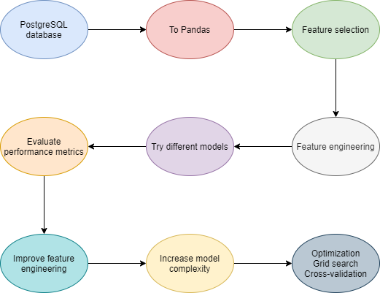
Workflow of project

Slide 4
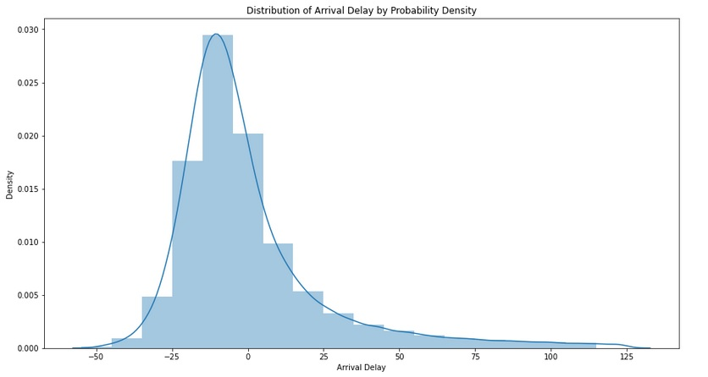
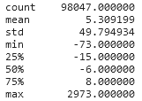
What We’re Trying to Predict How are flight arrival times distributed?

Slide 5

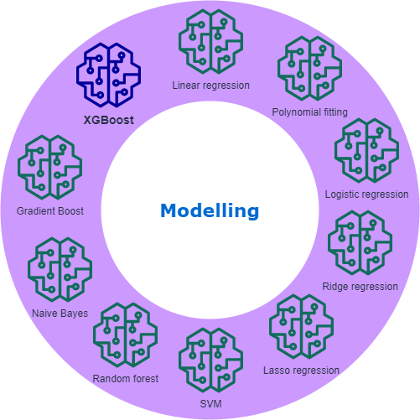
Feature engineering and modelling

Slide 6
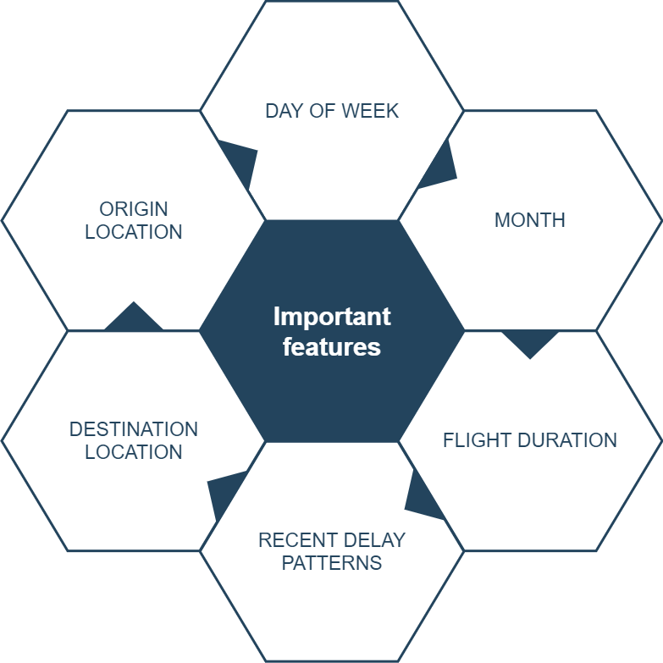
These features correlated with flight arrival delay

Slide 7
Choosing Features : Verifying Dependencies ANOVA Analysis
One Way ANOVA Results:

Slide 8
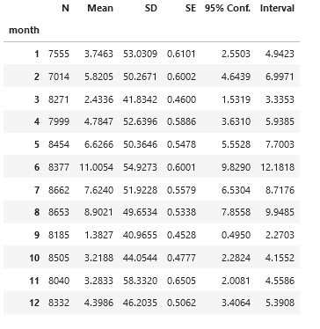
Choosing Features : Verifying Dependencies ANOVA Analysis
One Way ANOVA Results:

Slide 9
Choosing Features : Verifying Dependencies ANOVA Analysis
One Way ANOVA Results:
F statistic=27.16 Pvalue=1.93 * 10^(-57)

Slide 10
Choosing Features : Verifying Dependencies ANOVA Analysis
One Way ANOVA Results:
F statistic=27.16 Pvalue=1.93 * 10^(-57)
Conclusion: There is sufficient evidence to believe mean delay among months are different!

Slide 11
Choosing Features : Verifying Dependencies ANOVA Analysis
One Way ANOVA Results:
F statistic=27.16 Pvalue=1.93 * 10^(-57)
Conclusion: There is sufficient evidence to believe mean delay among months are different!
Task: Figure out what the dependencies are!

Slide 12
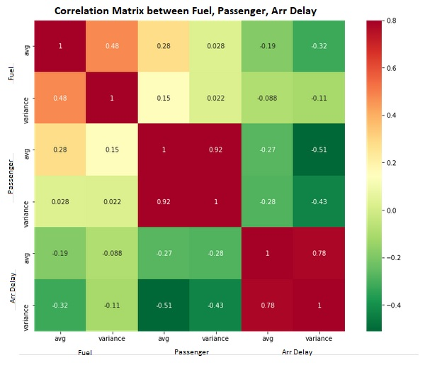
Features Dropped: Features not available one week before a flight, including departure delay
Fuel consumption and passengers were not good predictors of flight delay!

Slide 13
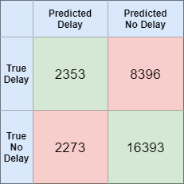
How well can we predict two possibilities?
Accuracy | 70%
Precision | 66%
Recall | 88%

Slide 14
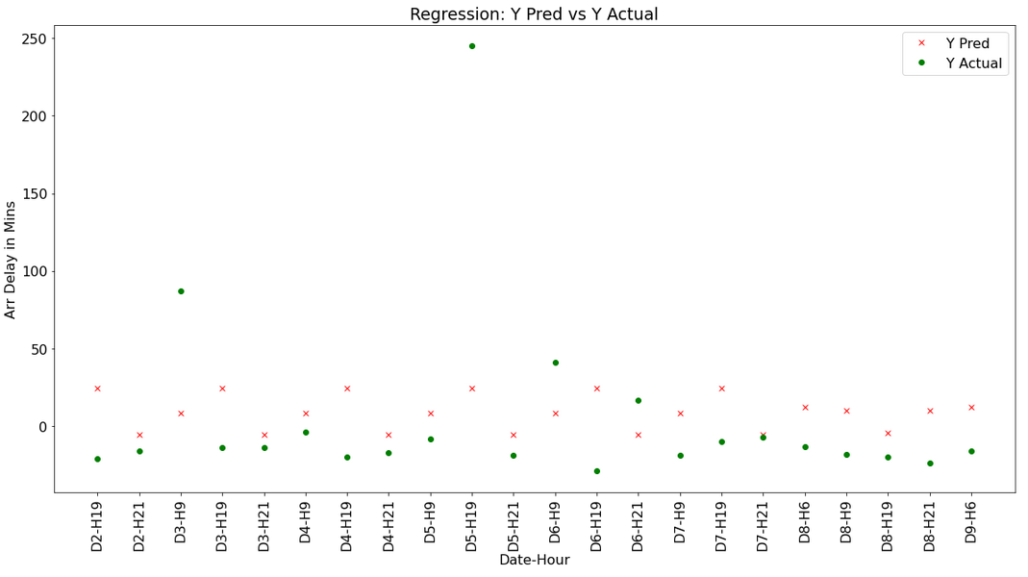
Regression Results
AA: MIA to ATL Route

Slide 15
Regression Results
AA: MIA to ATL Route
RSquare=0.04

Slide 16
Conclusion
Use patterns found by models
Increase Support for busy times and airports
Eliminate causes of big departure delay further where possible for better metrics
Continue to strive for better customer satisfaction

Slide 17
THANK YOU!
Questions?

